Slide 1
A Review on
“Simulation Model of the Computer’s Units and
Peripheral Equipment Interaction” 3
Natalia Efimushkina, Sergey Orlov, Nikolai Khrisanov
Submitted By: Tasfia Anika Bushra (23166013)

Slide 2
Overview
Principles of constructing a simulation model for studying computer I/O subsystems.
Selection of input-output device characteristics and parameter structuring.
Modeling typical hardware peripherals like keyboards and monitors with probabilistic data processing.
Developed in Java using NetBeans 8.1 with an animated user interface.
Visual representation of interrupts, control signal generation, and data transfer.
User interface for mode and simulation parameter settings.
Presentation of simulation results via time charts and numerical values.
Operation modes: information input, input/output to a monitor, and data processing/output to a monitor.
Study results confirming model adequacy in simulating system modes.

Slide 3
Summary

Slide 4
1.1 Motivation
Introducing a specialized simulation model for Informatics, Computer Science, and Software Engineering bachelor's degree programs.
Objective: Stimulating student engagement by thoroughly examining computer hardware input-output subsystems.
Features:
Encourages curiosity and motivation among students.
Interactive, animated interface for enhanced engagement.
Provides estimated time characteristics for studying device performance factors.

Slide 5
1.2 Contribution
Detailed models demonstrating interactions between central and peripheral devices in a personal computer.
Simulation model enabling detailed exploration of data input and output processes through animated visualization and user-friendly interface.
Significance as an educational resource for students studying computer science and related subjects.
Potential contribution to opening new avenues for research in computer technology.

Slide 6
1.3 Methodology
Model Focus: In-depth analysis of the input-output subsystem's computational operations, allowing for the exploration of numerous variables affecting the performance of subsystem devices.
Simulation Environment: Created in NetBeans 8.1 using Java, this environment makes use of a variety of initial data, such as CPU speed, number of I/O operations, processor instructions, and character volume of input/output.
Operational Modes: The model can track the stages of input-output command execution by operating in either "Continuous" or "Cycle by Cycle" mode. Types of operation include input/output, only input, and no input at all. These modes impact the use of the keyboard and display systems.
Simulation Termination: The simulation program ends after a predetermined number of instructions have been completed. The results are displayed using time diagrams and numerical values, highlighting the average occupancy rate and main device operation times.
Study Focus: primarily looks at the common I/O subsystem of contemporary computers, showing outcomes and quantifying modeling errors within reasonable bounds for teaching purposes.
Second Model Focus: Examines how the random access memory (RAM) external memory subsystem operates in direct memory access (DMA) mode, addressing single and multi-program modes with given device and task parameters.
Specifications of the Device and Task: involves information specific to a given task, such as the number of HDDs used for storage, the type of operation (read or write), the length of the file and record, processor speed, bus and bridge capacities, RAM, and external memory size.
Simulation Outputs: Through a series of processor operations and file access commands, the simulation illustrates the time characteristics of service tasks, such as the total program execution time, graphics, and device processing ratio.

Slide 7
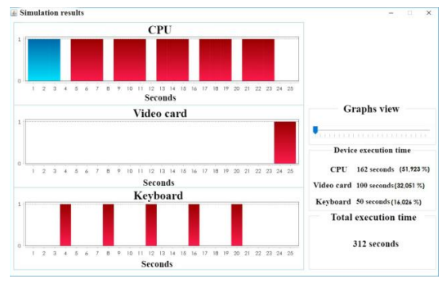
Results
Here is an example of the screen form of the simulation results:
Execution Time: CPU - 162s (52%), Video Card - 100s (32%), Keyboard - 50s (16%).
Total Execution time was 312s
[ s = seconds ]

Slide 8
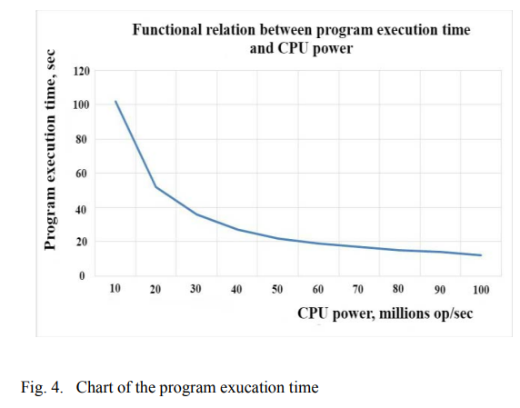
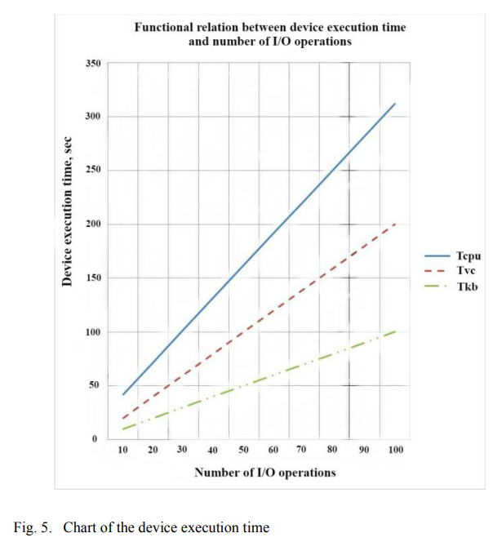
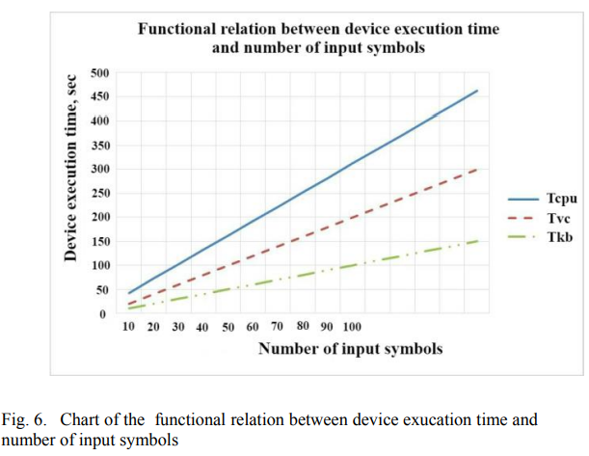
Results
Above figure shows that when CPU power increases, program execution time decreases.
Above figure shows execution time increases with number of I/O operations. Typical CPU takes more time than the video card or keyboard whereas keyboard takes least execution time.
Above figure shows execution time increases with number of input symbols. Typical CPU takes more time than the video card or keyboard whereas keyboard takes least execution time.

Slide 9
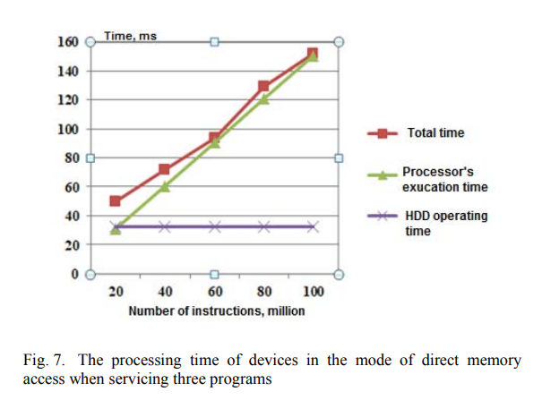
Results
The model allows you to study the features of the functioning of the subsystem DMA in single-and multiprogram mode.
The initial data for the simulation are the parameters of the subsystem's devices and the tasks (programs) that it serves.
In case of DMA
Total time was about 150ms
Processor’s execution time was 150ms
HDD’s execution time was about 35ms

Slide 10
1.4 Conclusion
In order to provide a thorough analysis of data input-output processes through an animated simulation, the paper presents models that explain interactions between central and peripheral devices in a personal computer. These models can be used for computer science and technology research as well as training.

Slide 11
2. Limitations

Slide 12
2.1 First Limitation - Simplified System Representation
The simulation model may oversimplify the complexities present in real-world computer systems, despite concentrating on user program operations and device interactions.
The accuracy of its representations may be impacted by an incomplete understanding of complexities such as dynamic computer architectures, environmental variables, or hardware malfunctions.
The complex interactions between hardware and ambient elements present in actual computer configurations may not be fully captured by the model.

Slide 13
2.2 Second Limitation - Scope Constraints
The simulation mainly focuses on analyzing particular subsystems and their functions within peripheral device operations and computer hardware interactions.
Because of its narrow focus, this method may not be as applicable in a variety of real-world situations, which could reduce its usefulness for more comprehensive system analyses.
Its limited scope may make it more difficult for it to appraise a variety of computing environments, which would reduce its general applicability.

Slide 14
3. Synthesis

Slide 15
3. Synthesis - Future Scope
Enhanced Real-World Simulation: By incorporating complexity like various hardware variations and environmental influences, the simulation model can be improved to better reflect real-world scenarios.
Integration of Machine Learning: Investigate how to incorporate machine learning algorithms into the simulation to boost its capacity for prediction and enable dynamic system modifications for better performance and flexibility.

Slide 16
Thank you

